Slide 1
Retail Sales Prediction
Report

Slide 2
The opportunity
Increase predictability of sales quantities in others to maximize markup return

Slide 3
The approach
Develop a short term dynamic forecasting model leveraring ARIMA technique for forward predictions
Build a machine learning models to automate long term sales predictions

Slide 4
The Data
Dataset source: Kaggle
Description: Dataset is deriving from the aggregation of 3 tables
Our target feature is ‘Weekly_Sales’
Data covers the period from Feb 2010 to Feb 2013
Features
Sales
Stores
Store
Date
Temperature
Fuel_Price
MarkDown1
MarkDown2
MarkDown3
MarkDown4
MarkDown5
CPI
Unemployment
IsHoliday
Store
Dept
Date
Weekly_Sales
IsHoliday
Store int64
Type object
Size int64
Source: https://www.kaggle.com/manjeetsingh/retaildataset?select=sales+da

Slide 5
Data Wrangling
Data cleaning and tidy:
Merging of the 3 tables to form a single data set
Addition of a new column to sum up all markdowns
Correction of negative sales values by inputting zeros. This concerned 0.3% of data
Imputing gaps in markdowns by zeros assuming this correspond to period where the promotional activity was not active.
Size, Dept, Type: replacement of missing values by the mode
Removal of outliers for employment and Temperature
Data transformation:
For all numerical variables having high level of skewness, a log transformation was applied to correct the distribution to normal.
For categorical variables, binary standardardization has been applied
Datetime variable has been encoded by splitting every component of year, month, week and day

Slide 6
Key Findings
01 | Weekly sales highly influenced by the size of the store and the department . Other factors have little influence on sales performance
02 | Fuel price and year display some significant level of collinearity
03 | At the exception of christmas, holidays do not have significant impact on sales.
04 | Markdowns have typically low impact on sales however, since they only occur during specific period of the year, further analysis is required to understand their impact.
05 | Size of stores matters for markdowns, the bigger the store, the more effective the markdown
06 | Markdown 2 and 5 impact is more volatile as affected by fuel price.

Slide 7
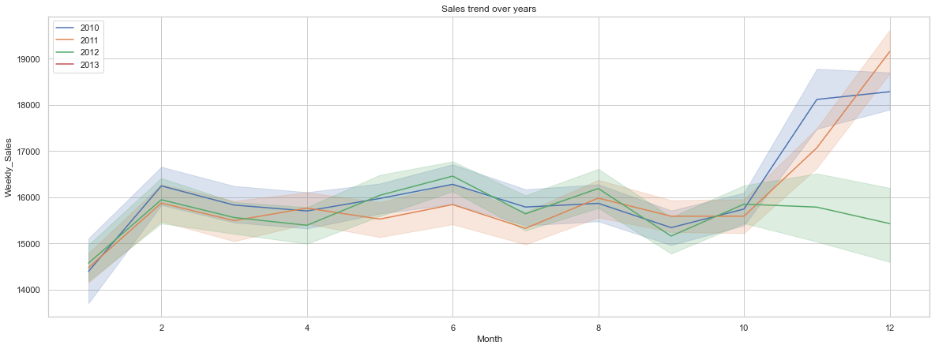
Exploratory Data Analysis - Sales trend

Slide 8
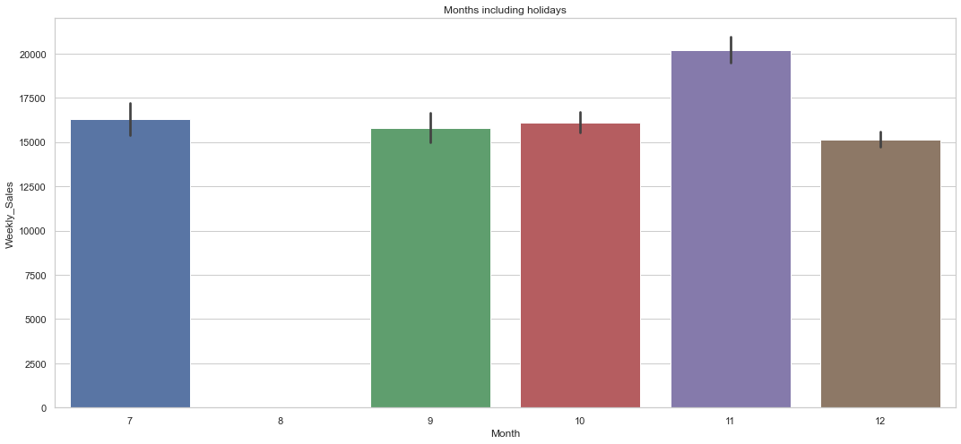
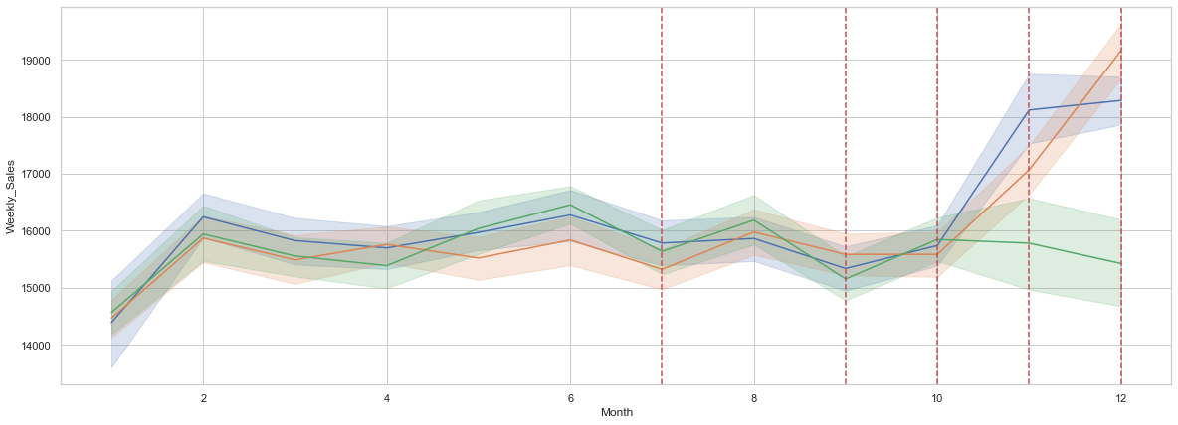
Exploratory Data Analysis - Holiday
Red lines shows holiday periods.

Slide 9
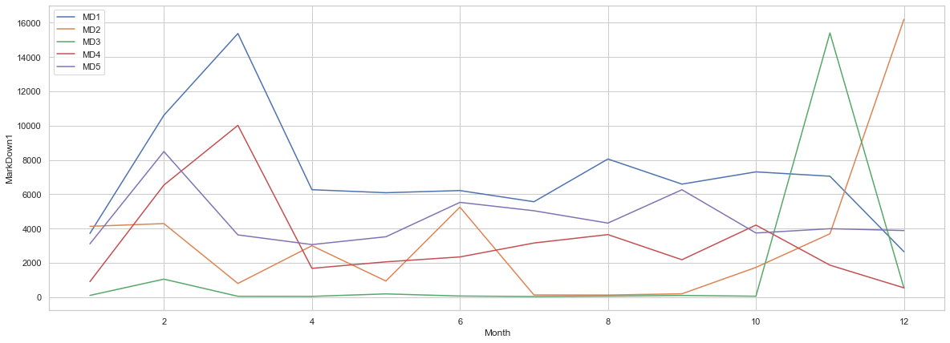
Exploratory Data Analysis - Markdowns depth

Slide 10
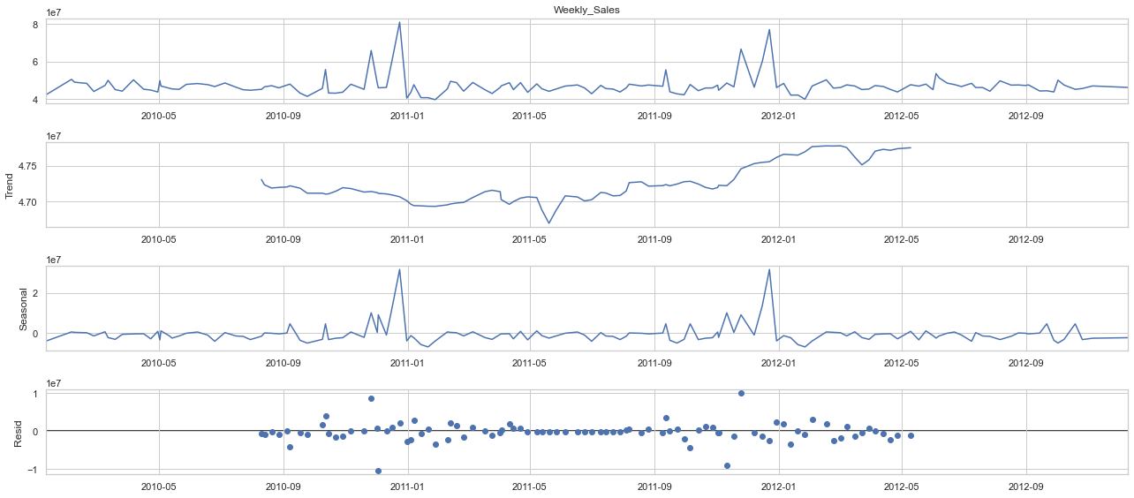
Seasonality and trend analysis

Slide 11
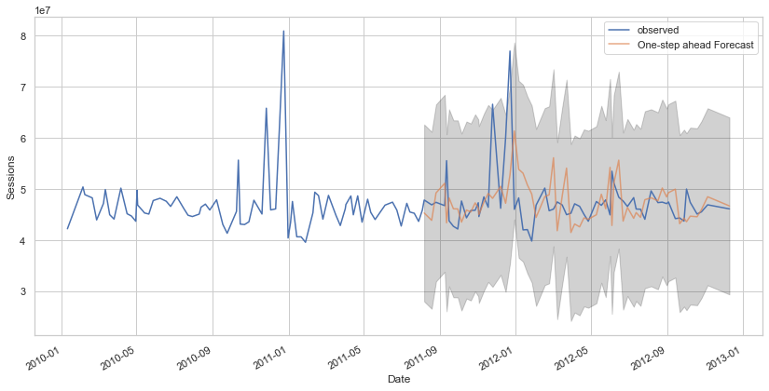
ARIMA model forecasting accuracy measure

Slide 12
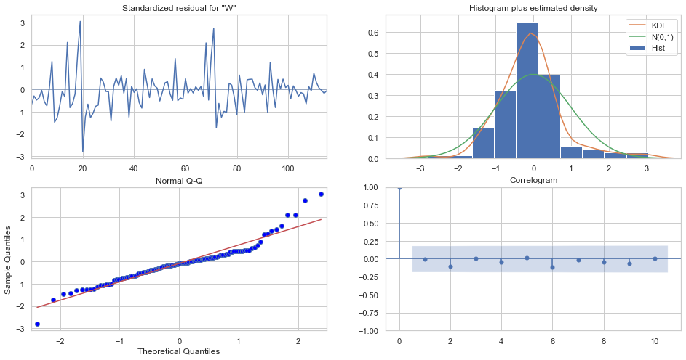
Time series model performance

Slide 13

Model selection
Elaborate forecast considering seasonality and trend impact
ARIMA
Random Forest
Naive forecast
Linear Regression
Gradient Boosting
Simple forecasting assuming no external factor affect sales.

Slide 14
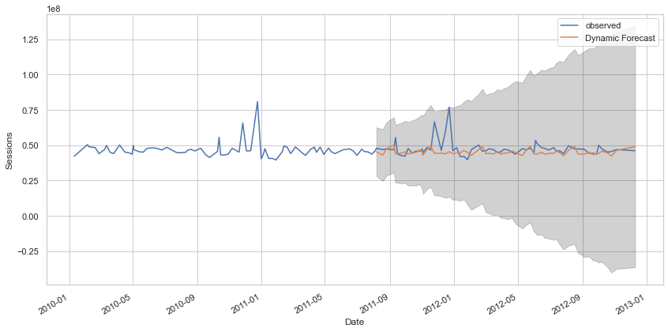
Sales forecasting using ARIMA

Slide 15
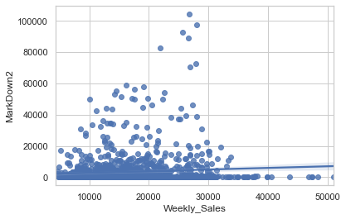
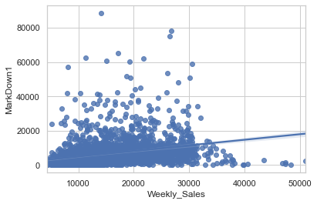
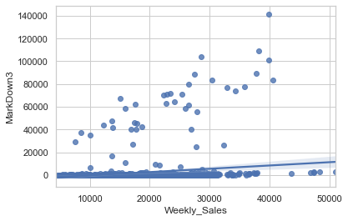
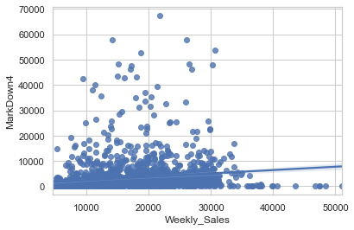
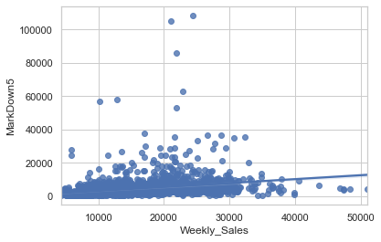
Recommendation: Markdowns depth

Slide 16
Model selection
Model | mse_score
mse_lm2 | 2.767948e+01
mse_gbr | 2.767948e+01
mse_rf | 1.683097e-04
mse_lm | 3.536717e-27
mse_ridge | -3.237305e-13
mse_lasso | -3.237305e-13

Slide 17
Future research
Customizing the model to forecast at department level will provide more granularity to predictions
Price elasticity study can also bring additional insight to understand sensitivity of each store/department to markdown and hence improve on depth of discount

